Slide 1
Data Bases 2 Optional Project
Telco Service
Marco Zanghieri
Michele Terziani

Slide 2
Index
Specification
Conceptual (ER) and logical data models
Trigger design and code
ORM relationship design
Entities code
Interface diagrams
List of components
UML sequence diagrams (optional)

Slide 3
Specifications
A telco company offers pre-paid online services to web users. From the Home page, the user can access a Buy Service page for purchasing a service package and thus creating a service subscription. The Buy Service page contains a form for purchasing a service package. The form allows the user to select one package from the list of available ones and choose the validity period duration and the optional products to buy together with the chosen service. The form also allows the user to select the start date of his/her subscription. After creating the order, the application bills the customer by calling an external service. If the external service accepts the billing, the order is marked as valid and a service activation schedule is created for the user.
The employee application allows the authorized employees of the telco company to log in. In the Home page, a form allows the creation of service packages. A Sales Report page allows the employee to inspect the essential data about the sales and about the users over the entire lifespan of the application.

Slide 4
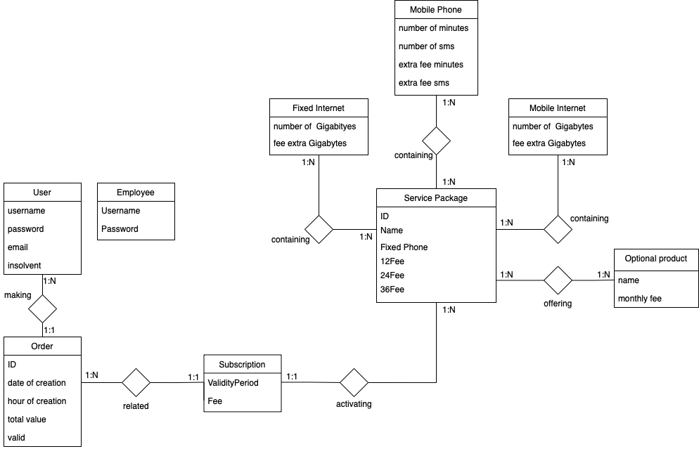
Entity Relationship

Slide 5
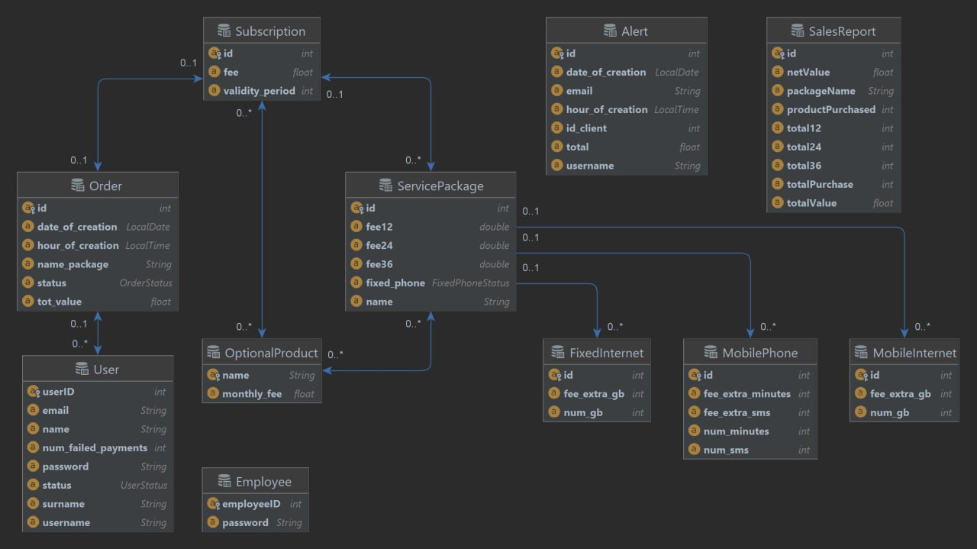
UML Diagram

Slide 6
Relational model
User (username, Password, Email, Insolvent)
Order (ID, UserID, DateCreated, HourCreated, TotalValue, Valid)
Subscription (ID, ValidityPeriod, Fee, IDOrder, IDPackage)
ServicePackage (ID, Name, FixedPhone, 12Fee, 24Fee, 36Fee)
OptionalProduct (Name, MonthlyFee)
FixedInternet(ID, NoOfGigabytes, ExtraFee)
MobileInternet (ID, NoOfGigabytes, ExtraFee)
MobilePhone (ID, NoOfMinutes, NoOfSms, ExtraFeeMin, ExtraFeeSms)

Slide 7
ORM design

Slide 8
Relationship “making”
making
User → Order @OneToMany
One user can make several subscription
TBD
Order → User @ManyToOne
Multiple orders can be done by a user
Owner of the relationship
Unidirectional 1:N
User
Order
1:N
1:1
User
*
Order
1
User
Order

Slide 9
Relationship “related”
related
Order → Subscription @OneToOne
An order refers to one subscription (if the order is valid)
Subscription → Order @OneToOne
A subscription is related to a (valid) order
Owner of the relationship
Bidirectional
Order
Subscription
0:1
1:1
Order
1
Subscription
1
Order
Subscription

Slide 10
Relationship “activating”
activating
Subscription → ServicePackage @ManyToOne
A subscription refers to the activation of one service package
Owner of the relationship
ServicePackage → Subscription @OneToMany
A service package can have multiple subscribers
TBD
Unidirectional 1:N
Subscription
ServicePackage
1:1
1:N
Subscription
1
ServicePackage
Subscription
*
ServicePackage

Slide 11
Relationship “containing”
containing
Service Package → Service @ManyToOne is necessary to show the service contained inside of the service package
Owner of the relationship
FetchType = FetchType.EAGER to let the costumer get the service details associated with a service package via relationship navigation
Service → Service Package @OneToMany is no requested, but mapped for simplicity
Service Package
Service
1:1
1:N
Service
Package
*
Service
Service Package
1
Service

Slide 12
Relationship “containing”
containing
Service Package → Optional @ManyToMany is necessary to show the optional products contained inside of the service package
Owner = either Service Package or Optional Product
FetchType = FetchType.EAGER to let the costumer get the optional products associated with a service package via relationship navigation
Service → Optional @ManyToMany is no requested, but mapped for simplicity
Service Package
Optional
1:N
1:N
Service
Package
*
Optional
Service Package
*
Optional

Slide 13
SQL DDL
create table user (ID int default 999999 not null primary key, username varchar(45) not null, password varchar(45) not null, email varchar(45) not null, name varchar(45) not null, surname varchar(45) not null, status binary(1) not null, num_failed_payments int default 0 not null );
create table `order` (id int auto_increment primary key, customer_id int not null, subscription int null, date_of_creation date not null, hour_of_creation time not null, total_value decimal not null, valid int not null, name_package varchar(20) null, constraint order_ibfk_1 foreign key (customer_id) references user (ID) on update cascade on delete cascade, constraint order_ibfk_2 foreign key (subscription) references subscription (id) on update cascade );

Slide 14
SQL DDL
CREATE TABLE `subscription` (
`id` int(6) NOT NULL AUTO_INCREMENT,
`id_order` int(6) NOT NULL,
`id_package` int(6) NOT NULL,
`validity_period` decimal NOT NULL,
`fee` decimal NOT NULL
PRIMARY KEY `id`
COSTRAINT `id_order` FOREIGN KEY (`order`) REFERENCES `order` (`id`)
COSTRAINT `id_package` FOREIGN KEY (`package`) REFERENCES `package`
(`id`) ON DELETE CASCADE, ON DELETE CASCADE
)
CREATE TABLE `package` (
`id` int(6) NOT NULL AUTO_INCREMENT,
`name` varchar(45) NOT NULL DEFAULT=`999999`,
`fixed_phone` number(1) NOT NULL,
`12Fee` decimal NOT NULL,
`24Fee` decimal NOT NULL,
`36Fee` decimal NOT NULL,
PRIMARY KEY `id`
)
CREATE TABLE `product` (
`name` varchar(45) NOT NULL,
`monthly_fee` decimal NOT NULL,
PRIMARY KEY `name`
)

Slide 15
SQL DDL
CREATE TABLE `fixed_internet` (
`id` int(6) NOT NULL AUTO_INCREMENT,
`num_gb` decimal NOT NULL,
`fee_extra_gb` decimal NOT NULL
PRIMARY KEY `id`
)
CREATE TABLE `mobile_phone` (
`id` int(6) NOT NULL AUTO_INCREMENT,
`num_minutes` decimal NOT NULL,
`num_sms` decimal NOT NULL,
`fee_extra_minutes` decimal NOT NULL
`fee_extra_sms` decimal NOT NULL
PRIMARY KEY `id`
)
CREATE TABLE `mobile_internet` (
`id` int(6) NOT NULL AUTO_INCREMENT,
`num_gb` decimal NOT NULL,
`fee_extra_gb` decimal NOT NULL
PRIMARY KEY `id`
)

Slide 16
SQL DDL (Alert Table and Triggers for insolvent users)
create table Alert (ID int auto_increment primary key, ID_Client int null, Username varchar(45) null, Email varchar(45) null, TotalAmount decimal null, DateOfCreation date null, HourOfCreation time null );
create trigger FailedOrder after update on `order` for each row UPDATE user SET user.status = 1,user.num_failed_payments = user.num_failed_payments + 1 WHERE user.ID = NEW.customer_id AND NEW.valid = 1;
create trigger InsolventUser after update on `order` for each row INSERT INTO Alert (ID_Client, Username, Email, TotalAmount, DateOfCreation, HourOfCreation) SELECT u.ID, u.username, u.email, o.total_value, o.date_of_creation, o.hour_of_creation FROM user AS u JOIN telco_service_db.Order AS o on u.ID = o.customer_id WHERE u.num_failed_payments > 2 AND o.id = NEW.id AND NEW.valid = 1;

Slide 17
SQL DDL (Sales Report Table and Triggers)
create table salesReport (ID int auto_increment primary key, id_package int null, PackageName varchar(45) null, TotalPurchase int default 0 null, TotalFor12 int default 0 null, TotalFor24 int default 0 null,
TotalFor36 int default 0 null, NetValue decimal default 0 null, TotalValue decimal default 0 null, productPurchased int default 0 null, constraint sales_package foreign key (id_package) references packages (id) ); create trigger newSalesReport after insert on packages for each row INSERT INTO salesReport SET PackageName = NEW.name, id_package = NEW.id;
create trigger updatePurchased after insert on subscribe_product for each row BEGIN update product set purchased = purchased + 1 where name = NEW.name_product; update salesReport set productPurchased = productPurchased + 1 where id_package IN (select id_package from subscription where id = NEW.id_subscribe); END;

Slide 18
SQL DDL (Sales Report Table and Triggers)
create trigger updateSalesReport after insert on subscription for each row BEGIN UPDATE salesReport SET TotalPurchase = TotalPurchase + 1, TotalValue = TotalValue + NEW.fee WHERE id_package = NEW.id_package; IF NEW.validity_period = 12 THEN UPDATE salesReport SET TotalFor12 = TotalFor12 + 1, NetValue = NetValue + (SELECT fee12 FROM packages WHERE id = NEW.id_package) WHERE id_package = NEW.id_package;
ELSEIF NEW.validity_period = 24 THEN UPDATE salesReport SET TotalFor24 = TotalFor24 + 1, NetValue = NetValue + (SELECT fee24 FROM packages WHERE id = NEW.id_package) WHERE id_package = NEW.id_package;
ELSEIF NEW.validity_period = 36 THEN UPDATE salesReport SET TotalFor36 = TotalFor36 + 1, NetValue = NetValue + (SELECT fee36 FROM packages WHERE id = NEW.id_package) WHERE id_package = NEW.id_package; END IF; END;

Slide 19
ORM design motivations
To avoid redundancy, in ”containing” relationship the entity ”Service” refers to the three offers that can be associated to a package. The offers are:
Fixed Internet
Mobile phone
Mobile internet
The ManyToMany relationship between Subscription and Optional Products it’s equal to the Package-Optional relation

Slide 20
@Entity @Table(name = "user", schema = "telco_service_db") @NamedQueries({ @NamedQuery(name = "User.checkCredentials", query = "SELECT r FROM User r WHERE r.username = ?1 and r.password = ?2"), @NamedQuery(name = "User.checkAlreadyRegistered", query = "SELECT COUNT(r) FROM User r WHERE r.email = ?1 or r.username = ?2") }) public class User { @Id @GeneratedValue(strategy = GenerationType.IDENTITY) @JoinColumn(name = "ID") private int userID; @JoinColumn(name = "username") private String username; @JoinColumn(name = "password") private String password; @JoinColumn(name = "email") private String email; @JoinColumn(name = "name") private String name; @JoinColumn(name = "surname") private String surname; @JoinColumn(name = "status") private UserStatus status; @JoinColumn(name = "num_failed_payments") private int num_failed_payments; @OneToMany(mappedBy ="client", fetch = FetchType.EAGER , cascade = CascadeType.REMOVE) private List<Order> orders;

Slide 21
@Entity @Table(name = "packages", schema = "telco_service_db") @NamedQueries({ @NamedQuery(name = "ServicePackage.findAll", query = "SELECT sp FROM ServicePackage sp"), @NamedQuery(name = "ServicePackage.findByName", query = "SELECT sp FROM ServicePackage sp WHERE sp.name=?1") }) public class ServicePackage { @Id @GeneratedValue( strategy = GenerationType.IDENTITY) private int id; @JoinColumn(name = "name") private String name; private FixedPhoneStatus fixed_phone; @JoinColumn(name = "fee12") private double fee12; @JoinColumn(name = "fee24") private double fee24; @JoinColumn(name = "fee36") private double fee36; @OneToMany(mappedBy = "servicePackage", cascade = CascadeType.ALL)) private List<Subscription> subscriptions; @ManyToOne(targetEntity = FixedInternet.class, fetch = FetchType.EAGER, cascade = CascadeType.ALL) @JoinTable(name = "fixed_internet")@JoinColumn(name = "fixed_internet_id", referencedColumnName = "id", nullable = false) private FixedInternet fixed_internet; @ManyToOne(targetEntity = MobileInternet.class, fetch = FetchType.EAGER, cascade = CascadeType.ALL) @JoinTable(name = "mobile_internet") @JoinColumn(name = "mobile_internet_id", referencedColumnName = "id", nullable = false) private MobileInternet mobile_internet; @ManyToOne(targetEntity = MobilePhone.class, fetch = FetchType.EAGER, cascade = CascadeType.ALL) @JoinTable(name = "mobile_phone") @JoinColumn(name = "mobile_phone_id", referencedColumnName = "id", nullable = false) private MobilePhone mobile_phone; @ManyToMany( fetch = FetchType.EAGER ) @JoinTable( name = "package_product", joinColumns = { @JoinColumn(name = "id_package") }, inverseJoinColumns = { @JoinColumn(name = "name_product") } ) private ArrayList<OptionalProduct> optionalProducts = new ArrayList<>();

Slide 22
@Entity @Table(name = "subscription", schema = "telco_service_db") @NamedQueries({ @NamedQuery(name = "Subscription.findByPackage", query = "SELECT s FROM Subscription s WHERE s.servicePackage = ?1"), @NamedQuery(name = "Subscription.findByOrder", query = "SELECT s FROM Subscription s WHERE s.order = ?1"), @NamedQuery(name = "Subscription.findByPackageAndPeriod", query = "SELECT s FROM Subscription s WHERE s.servicePackage = ?1 and s.validity_period = ?2") }) public class Subscription { @Id @GeneratedValue(strategy = GenerationType.IDENTITY) private int id; @JoinColumn(name = "validity_period") private int validity_period; @JoinColumn(name = "fee") private float fee; @OneToOne @JoinColumn(name = "id_order") private Order order; @ManyToOne @JoinColumn(name = "id_package") private ServicePackage servicePackage;
@ManyToMany( fetch = FetchType.EAGER ) @JoinTable( name = "subscribe_product", joinColumns = { @JoinColumn(name = "id_subscribe") }, inverseJoinColumns = { @JoinColumn(name = "name_product") } ) private ArrayList<OptionalProduct> optionalProductsSub = new ArrayList<>();

Slide 23
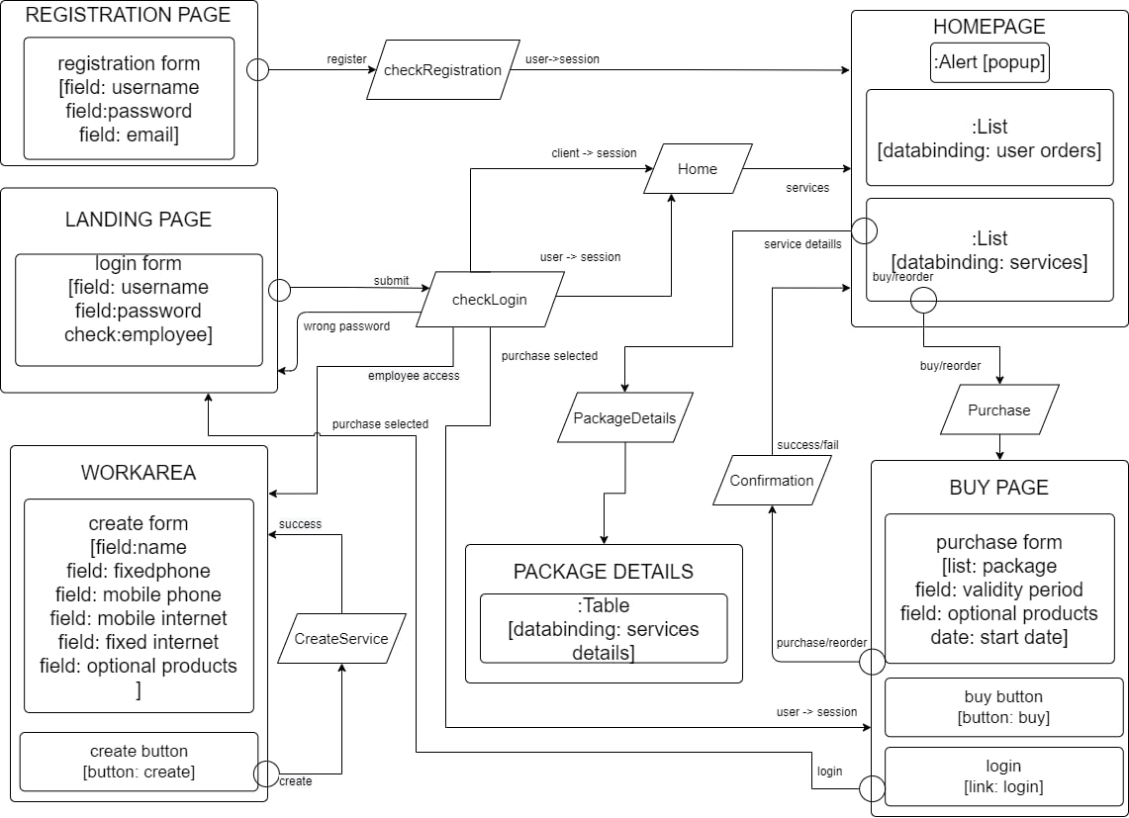
Component Diagram

Slide 24
Components
Client components
CheckLogin
CheckRegistration
Confirmation
CreateService
GoToHomepage
GoToOrders
GoToPackageDetails
GoToPurchase
LogOut
WorkArea
Back end components
User
Order
Subscription
Service Package
Alert
Sales Report
Business Components (EJBs)
EmployeeService
OrderService
ServicePackageService
SubscriptionService
UserService

Slide 25
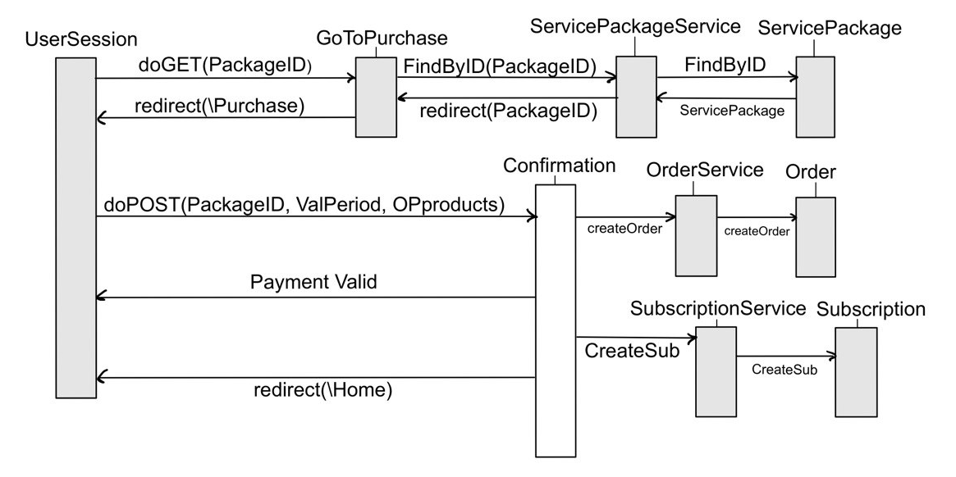
UML sequence diagram
Subscription of a Service Package from User

